Slide 1



Changing default values for VARCHAR and setting foreign keys to CASCADE on delete

Slide 2
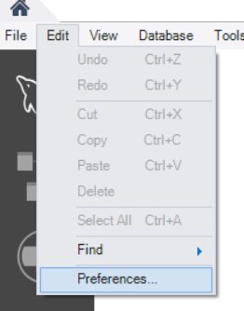
Changing VARCHAR
By default, VARCHAR() uses 45. But you can change the default!
Open up MySQL Workbench.
Go to “Edit” -> “Preferences…”
Go to “Modeling” -> “Defaults”.
Under “Column Defaults”, change Column Type from
VARCHAR(45) to VARCHAR(255).
Click “OK”. (If the program crashes, try these steps again.)
Now each new column with VARCHAR in your models will
have a default length of 255!

Slide 3
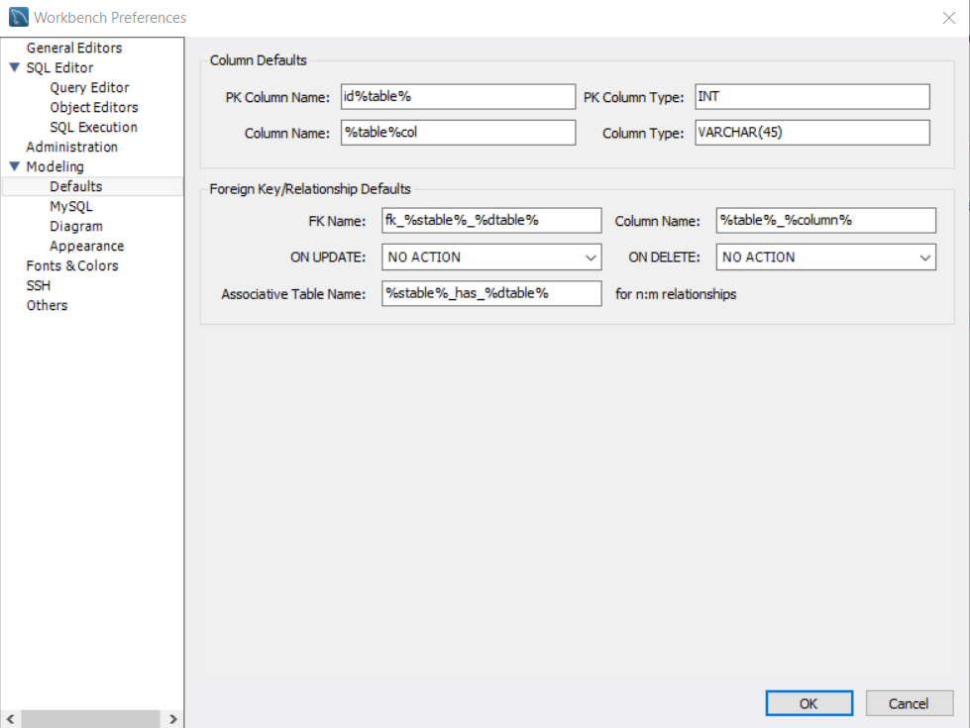
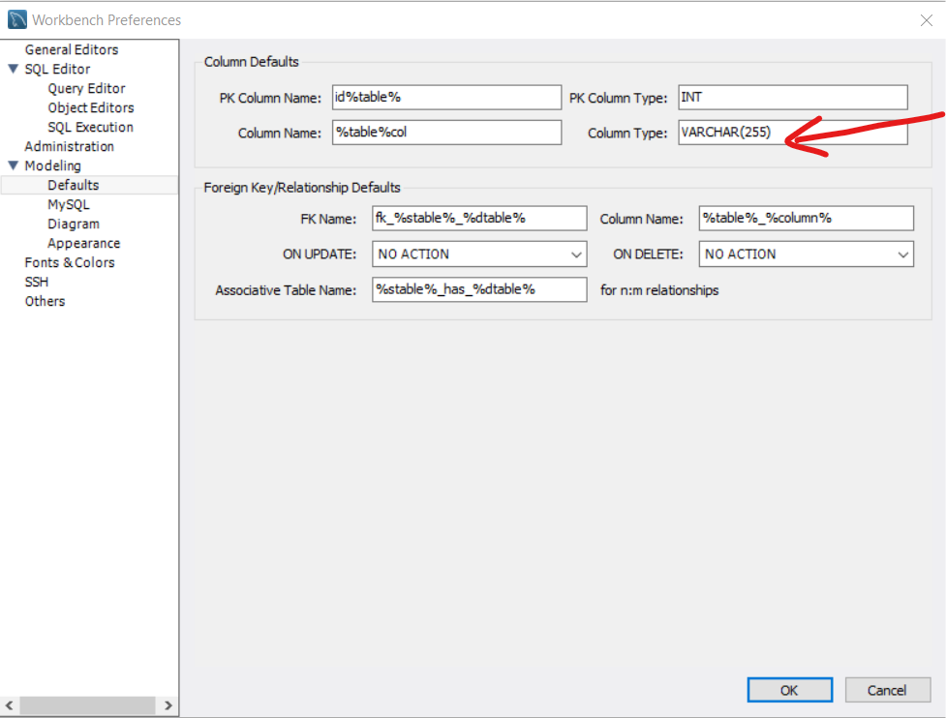
Changing VARCHAR

Slide 4
Changing ON DELETE from “NO ACTION” to “CASCADE”
Foreign keys are set to “NO ACTION” on delete and on update. But you can change the default just like with VARCHAR!
Open up MySQL Workbench.
Go to “Edit” -> “Preferences…”
Go to “Modeling” -> “Defaults”.
By “ON DELETE”, change from “NO ACTION” to
“CASCADE”
Click “OK”. (If the program crashes, try these steps again.)
Now all your NEW foreign keys will default to “CASCADE”
on delete!

Slide 5
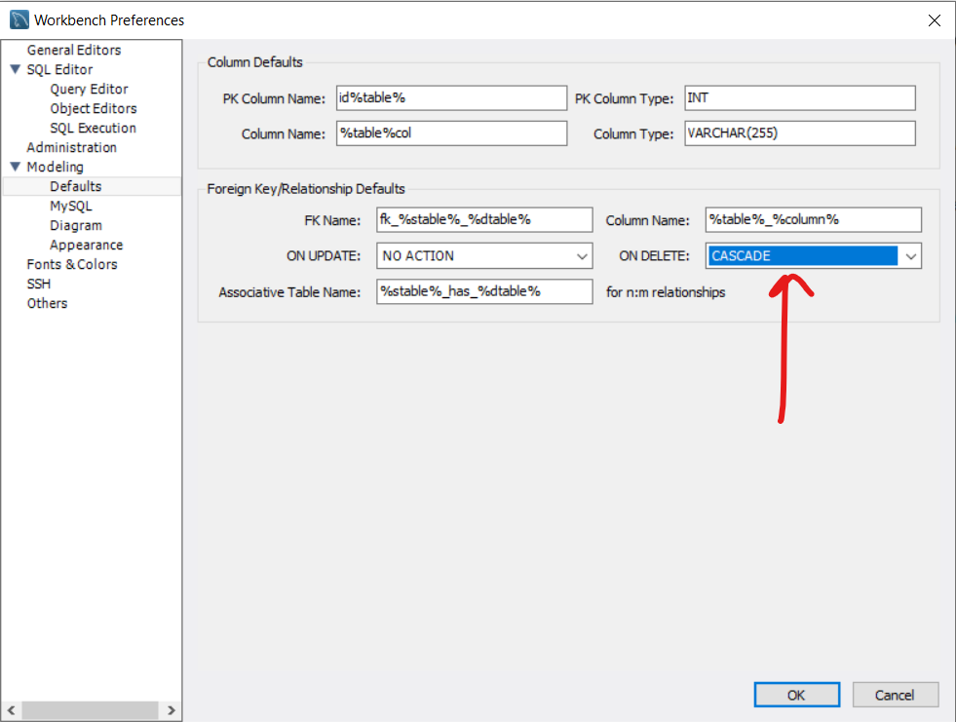
Changing ON DELETE from “NO ACTION” to “CASCADE”

